Slide 1

Bexar Central Appraisal District
How to Complete a
Business Personal Property
Rendition Form
For business owners in Bexar County

Slide 2
What is a Rendition?
A rendition is a confidential form that provides the Appraisal District with details about your business property to help determine its tax value.
By submitting a rendition, you help ensure that the Appraisal District can accurately assess the value of your business personal property.

Slide 3
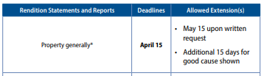
BPP Rendition Overview
A Business Personal Property (BPP) Rendition is a form used to report all taxable property owned by your business as of January 1. This includes both fixed assets (e.g., furniture, machinery) and inventory (e.g., goods for sale).
Deadline: State law requires you submit your BPP Rendition on or before April 15.
Penalty: A 10% penalty will be added to your tax liability if you miss the filing deadline.

Slide 4

Extension Requests
30-day extension may be requested in writing by April 15th.
New Deadline would be May 15th.
Notes:
How to request an extension?

Slide 5
What is Business Personal Property?
Tangible property owned and used by a business for the production of income.
BPP is generally movable and is not affixed to real property (like structures and land).
Like real property, business personal property is taxable in Texas and is valued by the CADs. BPP is primarily composed of Fixed assets and Inventory.
Notes:
What is Business Personal Property?

Slide 6
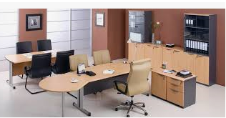

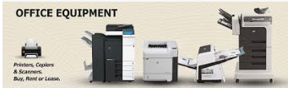

Business Personal Property
Fixed Assets (also called "use assets") are tangible items owned by a business, including:
  Furniture (e.g., office desks and chairs)
  Machinery (e.g., industrial machines)
  Office Equipment (e.g., printers, copiers)
  Vehicles (e.g., trucks, trailers)
  Aircraft and Watercraft

Slide 7


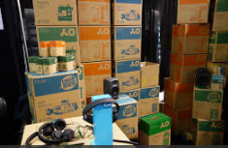

BPP continued…
Inventory & Supplies
Inventory refers to goods held by a business for consumption, processing, or sale. This includes:
Raw materials
Unfinished goods
Finished goods
Goods held for sale
Consigned goods
Floor-planned goods

Slide 8
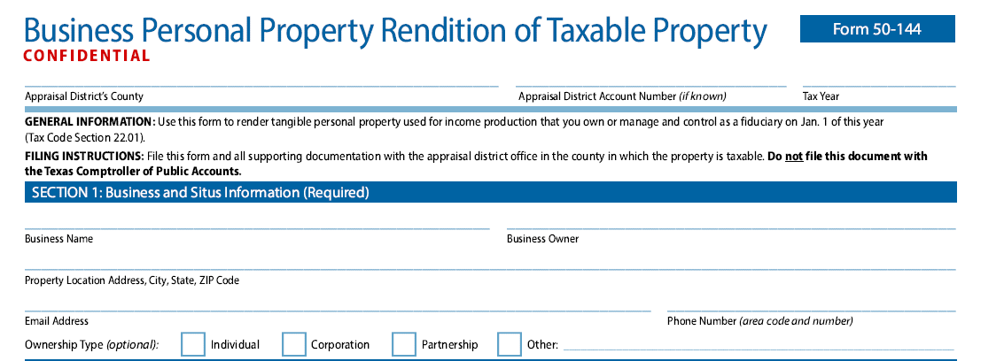
How to Complete
Section 1
Name of Business (DBA) and location of the property.
If the form is prepopulated, please review ownership and business location.
Provide email address and phone number so we can contact you with any questions.

Slide 9
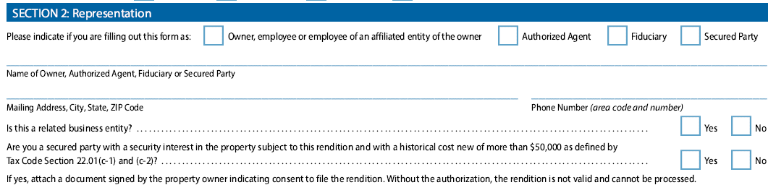

How to Complete
Section 2
Indicate who is completing the form
Please give us the mailing address you would like to receive your correspondence.
Are you a related business entity?
  Example: A parent company, a subsidiary, a company with the same owners
Are you a secured party with a security interest in the property?
  Do you have a legal financial claim on this property (like a loan or lien), and is the property worth more than $50,000 when new?
Notes:
You check one box that best describes you:
Owner, employee, or employee of an affiliated entity of the owner
→ You own the property, or you work for the owner (or a company connected to the owner).
Authorized Agent
→ You’re allowed to act on behalf of the owner (for example, a property manager or representative).
Fiduciary
→ You are legally responsible for managing someone else’s property or assets (like a trustee, executor, or guardian).
Secured Party
→ You are a lender or creditor who has a legal claim or lien on the property (for example, a bank).

Slide 10
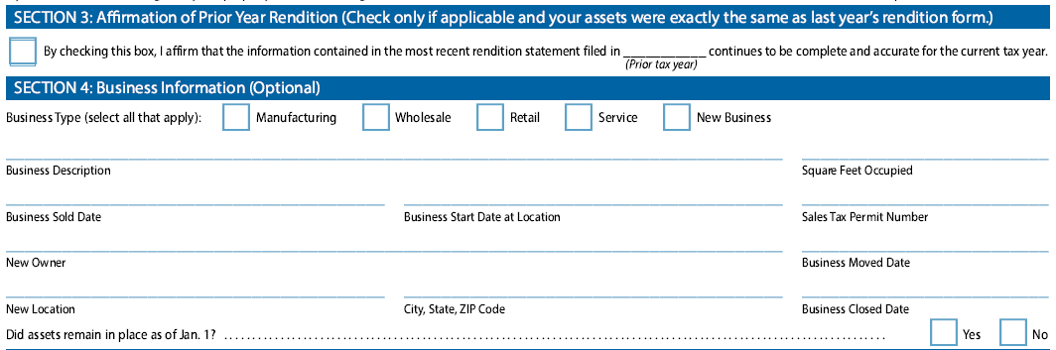
How to Complete
Section 3
Same as last year – If we do not have a recent asset detail list, this option will not be accepted
Section 4
Complete the information about your property. If you sold, moved, or closed your business this is where you will inform us.

Slide 11
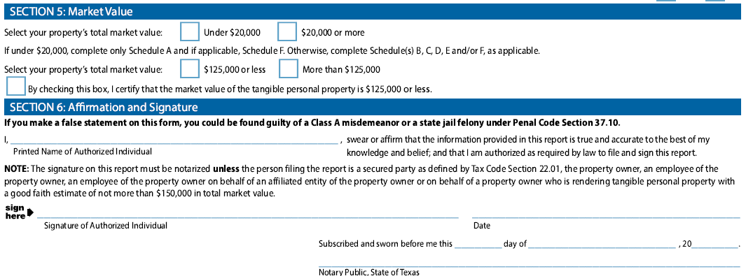




How to Complete
Section 5
Would your business sell for under $20,000 or over $20,000?
NEW per HB9 – Would your business sell for more or less than $125,000?
  You check this box if you are confirming (legally) that the total value is $125,000 or less.
Section 6
Print, sign, and date. Form only needs to be notarized if being completed by an agent and the value is over $150,000.
Notes:
Notary requirement (important)
The signature must be notarized unless:
You are the property owner, or
You are an employee of the owner, or
You are filing in good faith and estimating the total value at $150,000 or less, or
You are a secured party as defined by Texas tax law.
👉 If you don’t fall into those categories, you’ll need a notary public to witness and stamp your signature.

Slide 12
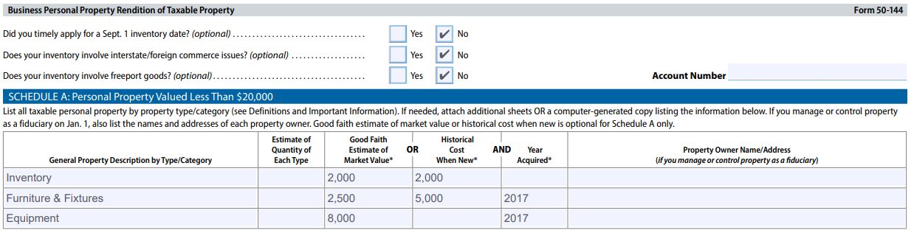
How to Complete: Under $20,000
Page 2
Answer the questions to the best of your ability, most of time all answers will be “No”.
Schedule A
If you selected “Under $20,000” on page one, complete this section.
Provide a generalized description of property as well as value. See image for example.
If under $20,000, rendition is complete and ready to submit.
If needed, attach additional sheets OR computer-generated copy list of the information.

Slide 13
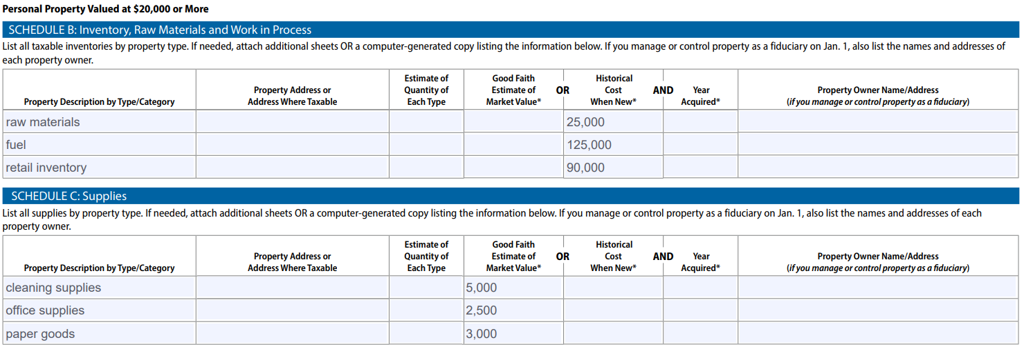
How to Complete: Over $20,000
Schedule B - Inventory
Report all inventory by COST on hand as of Jan 1 (Sept. 1).
Section C – Supplies
Report what is spent in a year on supplies and divide by 12.

Slide 14
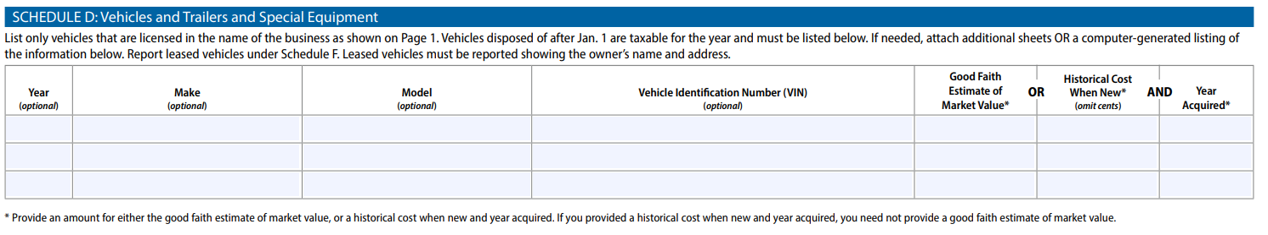
How to Complete: Over $20,000
Schedule D – Vehicles, Trailers, & Special Equipment
List all vehicles used for the production of income.
If you provide year of vehicle, make, model, and vin and we will assess your vehicle using NADA.
If you provide year acquired and cost information, we will depreciate the vehicle utilizing our internal schedules.
If needed, attach additional sheets OR computer-generated copy list of the information.
Notes:
As a product of the National Automobile Dealers Association, NADA has unique access to vast amounts of dealer sales data, giving their valuations a strong, insider perspective

Slide 15
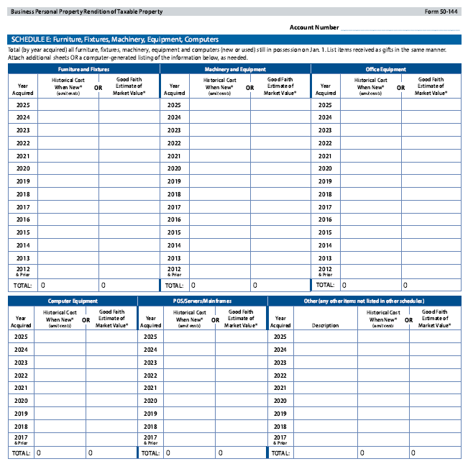
How to complete: Over $20,000
Schedule E – FFME & Computers
Provide the total cost (by year acquired) of all furniture, fixtures, machinery, equipment, and computers in possession on January 1.
Other would be your leasehold equipment such as signage and light fixtures.
If needed, attach additional sheets OR computer-generated copy list of the information.

Slide 16
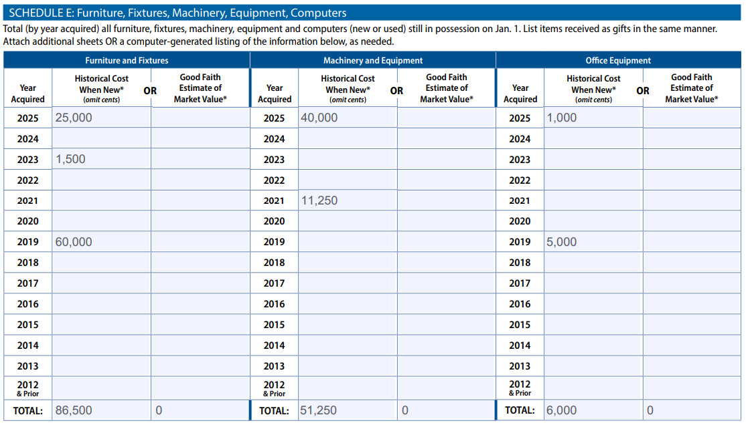
How to Complete: Over $20,000
Note: Not all machinery and equipment utilizes the same schedule. If your business uses both heavy equipment and light machinery, please provide an asset detail listing or one may be requested.
Notes:
0820 Agricultural, ALL Furniture & Fixture, All Office, All Restaurant, All Retail, All Signage, Doctor's Office, Exercise Eqpt (non-digital), Light Manufacturing, Mobile, Movie Theater, Warehouse Eqpt
1020 Above Ground Tanks, Auto Repair, Bakeries & Confectionaries, Barber, Beauty Salon, Broadcasting Eqpt, Dry Cleaning, Hospital Equipment, Large Tools (all trades), Mortuary & Embalming, Portable tanks, Spa, Warehouse Eqpt, X-ray eqpt 1520 Aircraft Manufacturing, Breweries, Cranes, Eyeglass Manufacturing, Heavy Manufacturing, Meat Packing, Wooden Billbards
2020 Petroleum Exploration, Petroleum Refining, Quarry Eqpt, Bank Eqpt,Utilty, Amusement Park Rides, Metal Billboards, Firearms

Slide 17
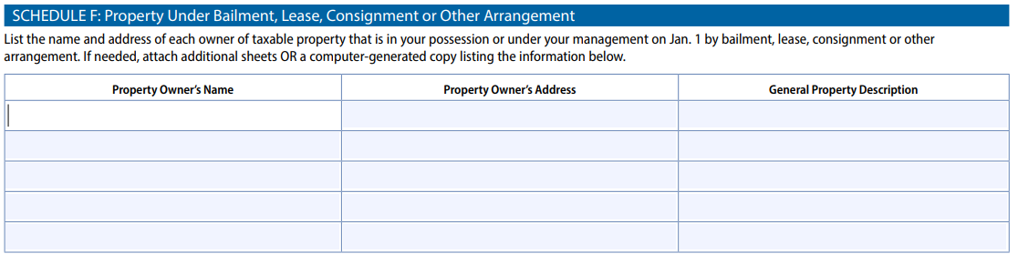
How to Complete: Over $20,000
Schedule F: Under Bailment, Lease, Consignment, or Other Arrangement
List any equipment that is leased or loaned to you by another party and provide the name and address of the owner of each item.
If over $20,000, rendition is complete and ready to submit

Slide 18
Bexar Central Appraisal District
Ways to file
Business Personal Property Rendition may be filed via:
- Mail to: PO BOX 839946
SAN ANTONIO, TX 78283
- Submit online : https://help.bcad.org
- Fax: (210) 242-2452
- Drop off: 411 N Frio St
    San Antonio, TX 78207

Slide 19
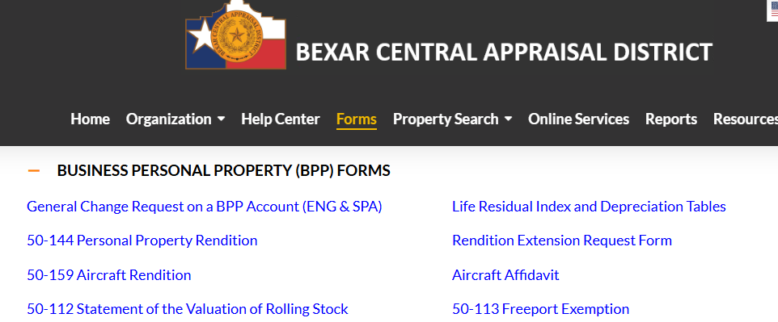


Rendition & extension request forms are located on the bcad.org website

Slide 20
BUSINESS PERSONAL PROPERTY CONTACT INFORMATION
Website: www.bcad.org
Mail: PO BOX 839946
SAN ANTONIO, TX 78283
Phone: (210) 224-2432
Help Center: https://help.bcad.org
Fax: (210) 242-2452
Quick Helpful Links
Rendition Form: https://bcad.org/wp-content/uploads/2025/12/50-144_BPP_Rendition_Of_Taxable_251217.pdf
BPP Forms and Documents: https://bcad.org/forms/

